Slide 1
Content Objective: Students will conduct a turing test
Tuesday June 18th
Recap Yesterday
What is AI actually?
Computer Vision / How does a computer “see”?
Homework
No homework in the course. But I will make you think!

Slide 2

Turn n’ Talk
Where do you place the worker who squashed the fly on your ethical spectrum (evil-good)? Why did you place it there?
Where do you place the robot women getting killed for fear of her killing her masters? Why did you place it there?
Of the three scenarios (Second Renaissance, Yogurt Taking Over, Sophia’s Utopian Dream) which do you think is the most likely? Why?

Slide 3
Class Ethical Data on Abortion
AI “Sees” Data / Used to Make Decisions
Should we make laws based on ethical data such as this?
17 Students Total
3 - No Opinion
2 - Good (save mother's life, prevent unwanted pregnancy, ease financial strain, prevent damaging foster care placement)
1 - Evil (should never take a life, except in matters of rape, mother endangerment)
12 - Neutral (Difficult choice for any mother, ¼ women get one at some point in their lifetime, most are already married and have children)
More on AI using Data to make choices tomorrow!

Slide 4
What is AI actually?

Slide 5
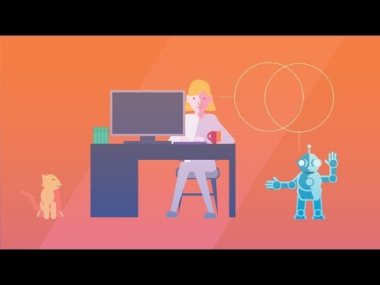
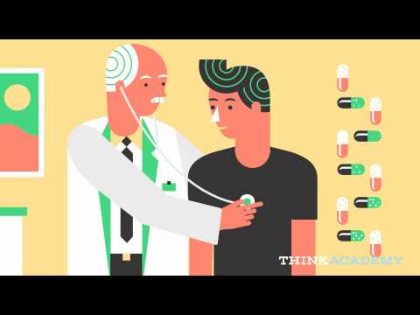
What is AI Wrap Up Video IBM Watson

Slide 6


Slide 7
How does a computer “see”?
Edge Detection Cat Slides

Slide 8
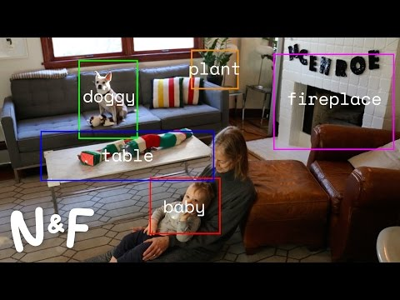
Computer Vision

